Slide 1
Data pipeline with PostgreSQL
M-DAS
Team: Nita, Chandeth and Roatny
Dec. 2023

Slide 2
CONTENTS
Scenario and Objective
Architecture
Our pipeline explanation
Key Challenges of PostgreSQL

Slide 3
Scenario
តថ Bank has recently launched a mobile app to provide its customers with convenient banking services. The mobile app generates a significant amount of data, including user transactions, account details, customer information, and more. The bank wants to leverage this data to gain actionable insights and enhance its business operations.
Objective
To build data pipeline using PostgreSQL is to enable តថ Bank to analyze the data generated by its mobile app and to unlock the potential of their mobile app data, gain valuable insights, and make data-driven decisions to enhance their business operations, improve customer experiences, and drive overall growth.
Course: Big Data

Slide 4



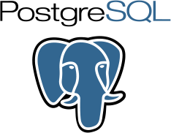

Data pipeline
Data Sources
Analytics & BI Tools
Transform
Indexing & Optim
Bank Mobile App
Data Ingestion
Storage
PostgreSQL provides built-in indexing mechanisms, and tools like EXPLAIN in PostgreSQL can assist in query optimization.
SQL Queries
Power BI or Python
Report generation
User transactions
Account details
Customer information
Pop up
Loan
More
& Data Quality
Course: Big Data

Slide 5

1. Data Sources
Streaming Data
Many data types generated
High Volume
High Velocity
More
Course: Big Data

Slide 6
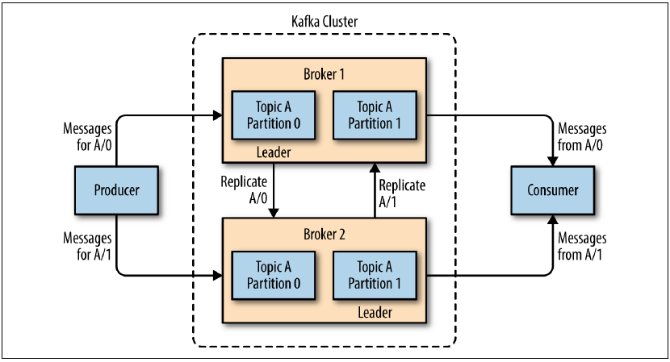
2. Data Ingestion Tools
Kafka is a distributed streaming platform that provides a scalable, fault-tolerant, and high-throughput system for handling real-time data streams
Course: Big Data

Slide 7
Kafka Flow
Data Generation
Kafka Topics & Producers
Kafka Brokers
Kafka Consumers
Processing
The bank mobile app generates data as users perform actions like transactions, payments, or account updates
The app's Kafka
producer component
captures the
generated data and
publishes it to
specific Kafka
topics, representing
different categories
of data.
Kafka brokers receive, store, and replicate the messages published by the app's Kafka producer, ensuring fault tolerance and durability.
Kafka consumer components integrated within the bank's backend systems or other consuming components subscribe to the relevant Kafka topics.
Once the data is consumed by the Kafka consumers, it can be further processed as per the requirements of the bank.
The streaming data is processed in small batches or micro-batches

Slide 8
3. Data Preparation Tools
Spark is a fast and distributed computing framework that provides high-level APIs for processing large-scale data sets.
Course: Big Data

Slide 9
Spark process
Data from Kafka
Transform
Quality Checks
Spark connects to the Kafka cluster and consumes the data from Kafka topics, receiving real-time data streams.
Spark Streaming or Spark batch processing is used, depending on the data characteristics and requirements
Spark performs data transformation operations, including cleansing, filtering, enriching, and aggregating the ingested data.
Data quality checks involve verifying the data against predefined criteria or business rules. These checks can include validating data types, checking for missing or duplicate values, ensuring referential integrity, and identifying outliers or anomalies.
Course: Big Data

Slide 10
4.Storage
PostgreSQL is a powerful, open-source object-relational database system with over 35 years of active development.
Relational Database Management System: it organizes data into tables with predefined schemas and enforces relationships between the tables using primary keys and foreign keys.
ACID Compliance: ensuring the reliability and integrity of data transactions.
Data Integrity and Constraints: PostgreSQL supports various data integrity features such as unique constraints, foreign key constraints, check constraints, and not-null constraints.
Extensibility and Customization: This enables developers to extend the functionality of the database and tailor it to specific application requirements.
Advanced Querying Capabilities: provides a powerful SQL query language that supports complex queries, subqueries, joins, aggregations, and window functions.
Scalability and Performance: handle large datasets and high transaction loads. It supports parallel query execution.
Community Support and Ecosystem: PostgreSQL has a vibrant and active open-source community. The community provides extensive documentation, forums, and resources for support and knowledge sharing.
Course: Big Data

Slide 11
potential Drawback
Complexity
Scalability: it may face scalability challenges compared to some NoSQL databases or distributed systems. Scaling PostgreSQL horizontally across multiple machines can be more complex and may require additional tools or configurations.
Replication Lag: In certain replication scenarios, PostgreSQL's replication mechanisms may introduce some replication lag, resulting in a delay between updates on the primary database and the replicated instances. This delay can impact real-time data availability and synchronization.
Limited NoSQL Capabilities: it does not provide the same level of native support for NoSQL data structures and operations as some dedicated NoSQL databases.
Storage Requirements: PostgreSQL's data storage requirements can be higher compared to some other database systems. It may consume more disk space, particularly for certain data types, indexing structures, or replication mechanisms.
Third-Party Ecosystem: While PostgreSQL has a robust ecosystem, including extensions, libraries, and tools, it may not have the same breadth or diversity as some other database systems. This can limit the availability of specific add-ons or integrations for certain use cases.

Slide 12
5. Indexing & optimization
Improve Query Performance: enhancing the performance of database queries. By creating indexes on columns frequently used in WHERE clauses or JOIN conditions, the database can efficiently locate and retrieve the required data, reducing the query execution time.
Faster Data Retrieval: Indexing allows for faster data retrieval by organizing the data in a structured manner. Instead of scanning the entire table, the database engine can utilize indexes to locate specific rows or perform range scans, leading to improved query response times.
Avoid Full Table Scans: Without proper indexing, the database may need to perform full table scans, which can be resource-intensive and time-consuming, especially for large datasets. Indexes enable the database to perform targeted scans and retrieve only the relevant data.
Support Data Integrity: Indexes can enforce data integrity constraints, such as unique constraints or primary key constraints. These constraints ensure the consistency and accuracy of data by preventing duplicate values or null entries in critical columns.

Slide 13

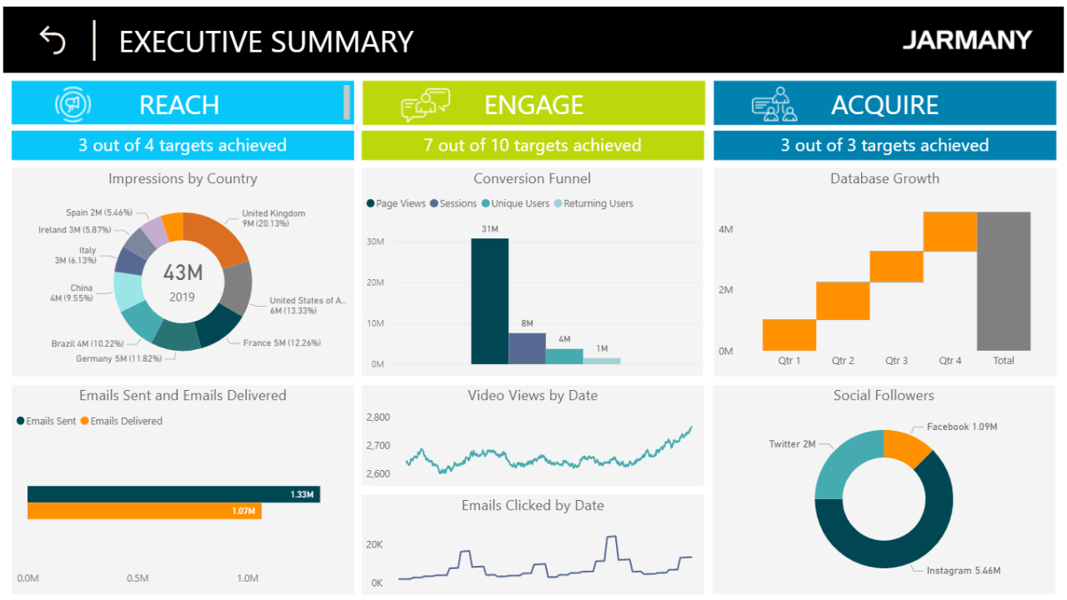
Analytics& Bi Tools
SQL queries are written to perform various analytical tasks on the data stored in PostgreSQL. These queries extract insights, perform aggregations, generate reports, and conduct statistical calculations based on the business requirements.
The analyzed data can be visualized and presented using business intelligence tools or data visualization platforms. These tools connect to PostgreSQL to create interactive dashboards, charts, and reports, enabling users to explore and gain insights from the data.
We could Power BI or Python Library to create our own dashboard.

Slide 14
THANK YOU
M-DAS
Course: Big Data
Dec.2023

